Slide 1
C.4 Virus Presentation– Oct 19 (ICS3C0)
Agenda
Slides C.4 Virus Presentation
Begin Today / Complete Next Week
Topics Will Be Assigned
Mark Spreadsheet
Catch-Up / Fill in those Blanks!
Upcoming
Monday: Continue Presentation Research

Slide 2
C.4 Virus Presentation– Oct 19 (ICS4C0)
Agenda
Slides C.4 Virus Presentation
Begin Today / Complete Next Week
Topics Will Be Assigned
Student Database Code Integration
Daniel’s Part
Kiran’s Part
Upcoming
Monday: Continue Presentation Research
Monday: Continue Integration of Student Code

Slide 3
Virus Topic Assignments
ISC3C – Grade 11
CIH Virus – 1998 - Ayub
Melissa Worm – 1999
Code Red Worm – 2001
Slammer Worm – 2003 - Darren
SoBig.F Worm – 2003 - Parmit
My Doom Worm – 2004 - Navdeep
Stuxnet Worm – 2010 - SukRaj
Cryptolocker Trojan – 2013 - Rickey
ZeroAccess Botnet – 2013 - Ethan
Superfish Adware – 2014 - Harkushal
Locky Ransomware – 2016 - Habusan
WannaCry Ransomware – 2017 - James
ISC4C – Grade 12
CIH Virus – 1998
Melissa Worm – 1999 - Kiran
Code Red Worm – 2001
Slammer Worm – 2003
SoBig.F Worm – 2003
My Doom Worm – 2004
Stuxnet Worm – 2010
Cryptolocker Trojan – 2013 - Rahul
ZeroAccess Botnet – 2013 - Daniel
Superfish Adware – 2014 - Antonio
Locky Ransomware – 2016
WannaCry Ransomware – 2017 - Calvin

Slide 4
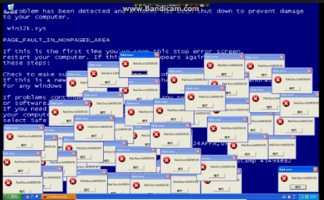
Computer Virus – 1980s /1990s
Method: Disk Based
Transmitted by sharing “infected” floppy disks (or USB memory stick)
Objective
Cause Mischief
Bragging Rights
Effects
Crash Computer
Corrupt Your Data And Programs
Print a funny message to your screen

Slide 5
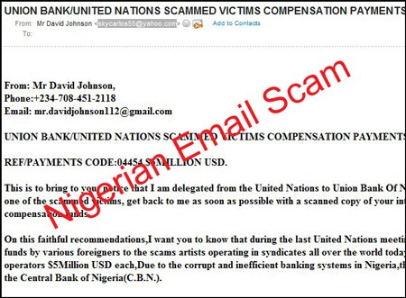
Computer Virus – 2000s
Method: Email Based / Web Based
Transmitted by “infected” emails
Transmitted by “hacked” web sites
Objective
Trick You into “clicking” on the virus software
Effects
Hack your computer
Steal your “contacts” list
Loss of personal (Financial) information
Financial Scams

Slide 6
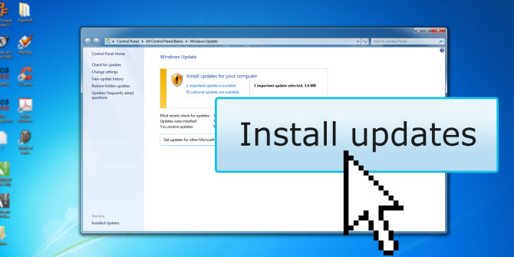
Computer Virus – 2010s
Method: Network Based
Direct Attack on your PC/Device through your Internet Connection
Defeat the “Firewall” Software on your PC / Device.
Objective
To exploit the software vulnerabilities of Operating System & Programs
To keep ahead of the security fixes provided by Microsoft / Apple / Android
Effects
Hack your computer
Steal your “contacts” list
Loss of personal (Financial) information
Financial Scams

Slide 7
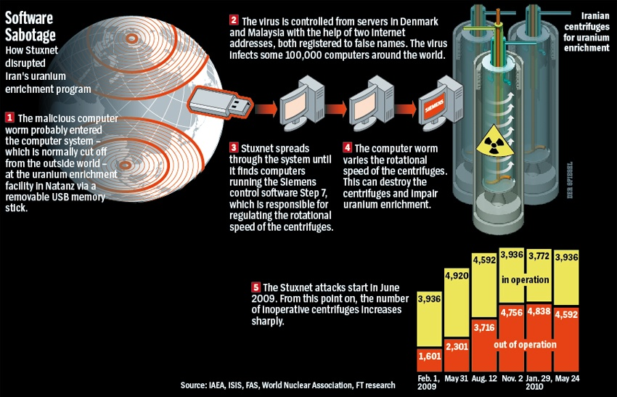
Government “Worms”
Method: Network Based
Direct Attack on Government Network
Objective
Steal state secrets
Military info
Damage Systems
Destroy Equipment
Effects
Espionage
Interfere with Government Projects (Elections)
STUXNET Worm

Slide 8
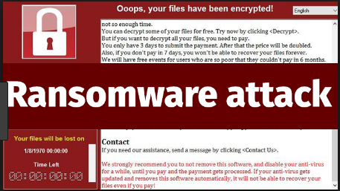
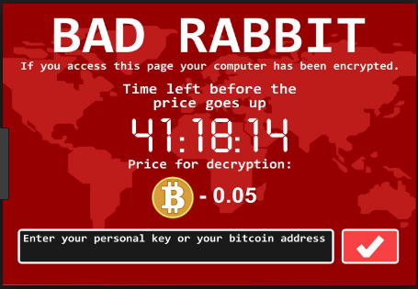
Ransomware
Method:
?
Objective:
Invade you PC / Network
Encrypt (Disable) Important Data
Hold Data for “Ransom”
Effects:
?

